Slide 1



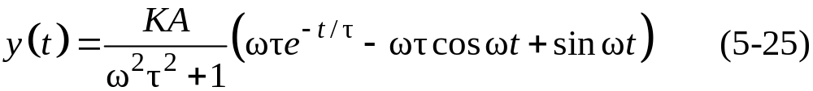
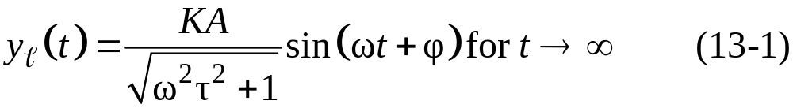
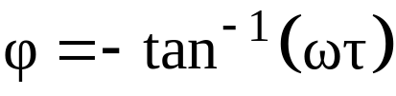
Frequency Response Analysis
Sinusoidal Forcing of a First-Order Process
For a first-order transfer function with gain K and time constant , the response to a general sinusoidal input, is:
Note that y(t) and x(t) are in deviation form. The long-time response, y_{l}(t), can be written as:
where:

Slide 2
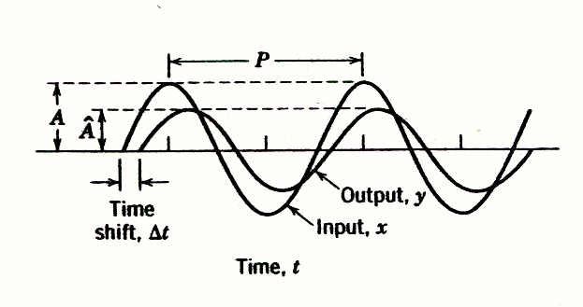



Figure 13.1 Attenuation and time shift between input and output sine waves (K= 1). The phase angle of the output signal is given by , where is the (period) shift and P is the period of oscillation.

Slide 3
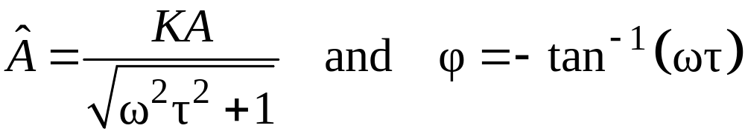

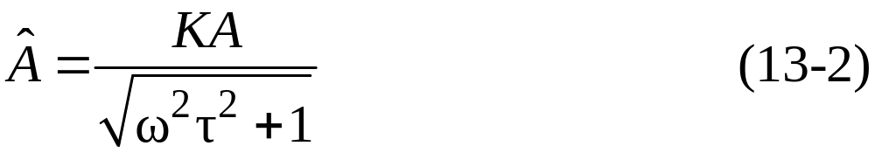
Frequency Response Characteristics of
a First-Order Process
The output signal is a sinusoid that has the same frequency, ω, as the input.signal, x(t) =Asinωt.
The amplitude of the output signal, , is a function of the frequency ω and the input amplitude, A:
3. The output has a phase shift, φ, relative to the input. The amount of phase shift depends on ω.

Slide 4
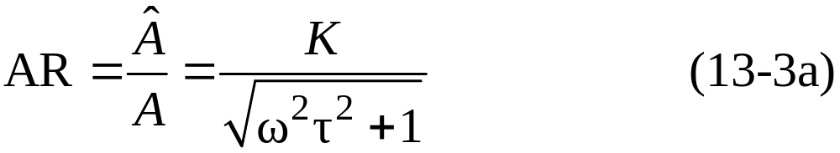
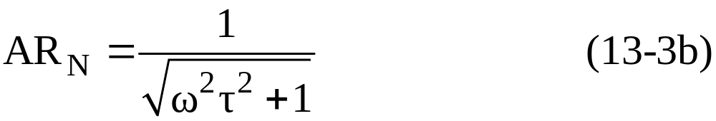
Dividing both sides of (13-2) by the input signal amplitude A yields the amplitude ratio (AR)
which can, in turn, be divided by the process gain to yield the normalized amplitude ratio (AR_{N})

Slide 5

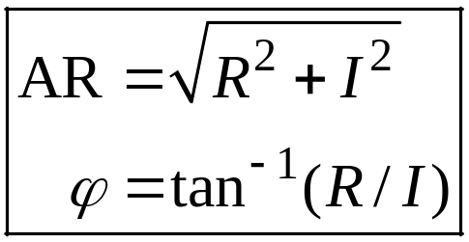

Shortcut Method for Finding
the Frequency Response
The shortcut method consists of the following steps:
Step 1. Set s=jω in G(s) to obtain .
Step 2. Rationalize G(jω); We want to express it in the form.
G(jω)=R + jI
where R and I are functions of ω. Simplify G(jω) by multiplying the numerator and denominator by the complex conjugate of the denominator.
Step 3. The amplitude ratio and phase angle of G(s) are given by:

Memorize

Slide 6
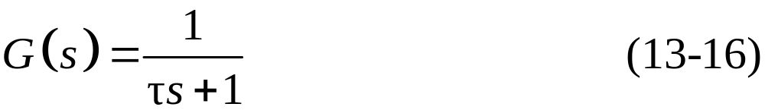

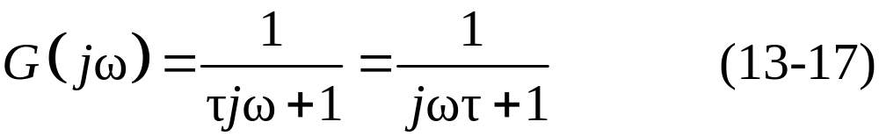

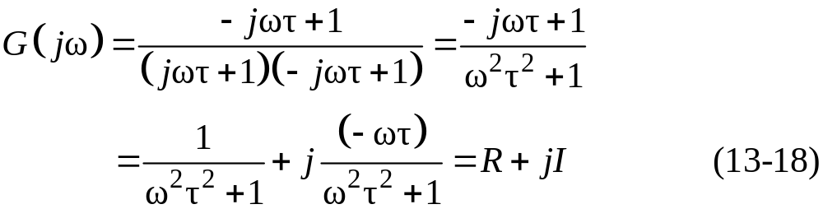
Example 13.1
Find the frequency response of a first-order system, with
Solution
First, substitute in the transfer function
Then multiply both numerator and denominator by the complex conjugate of the denominator, that is,

Slide 7
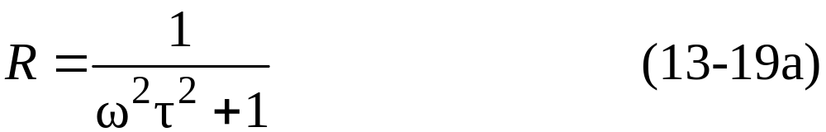
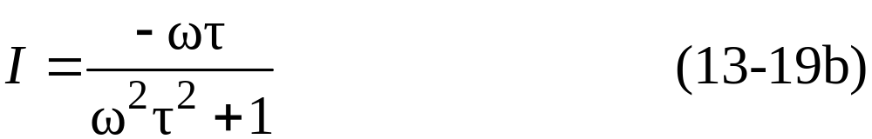
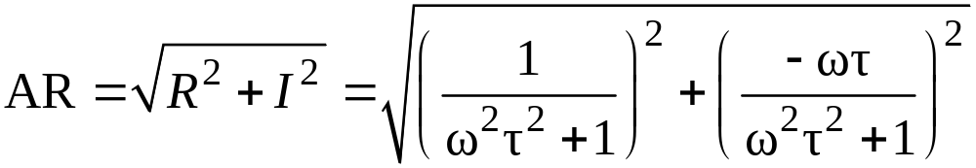
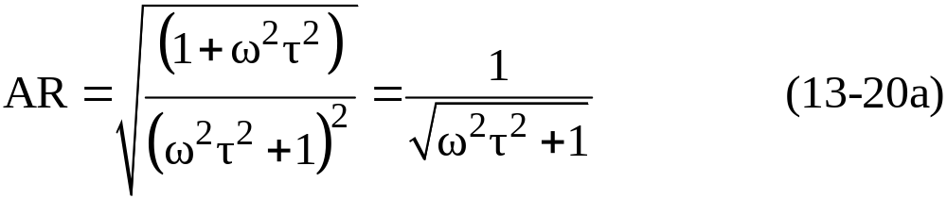
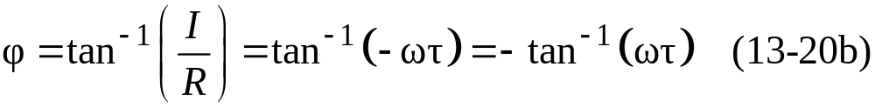
where:
From Step 3 of the Shortcut Method,
or
Also,

Slide 8
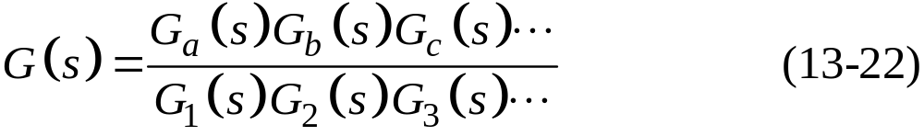
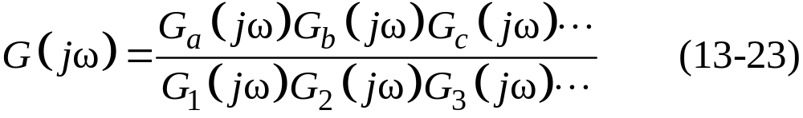
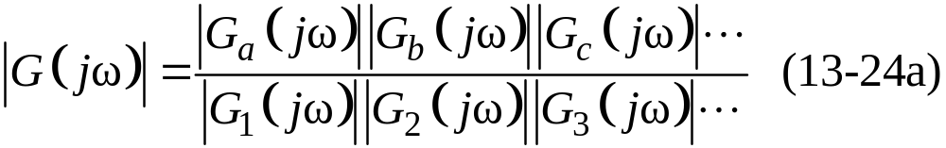
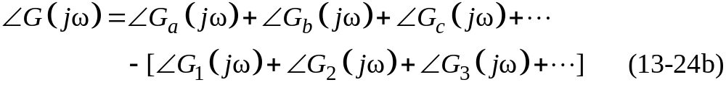
Complex Transfer Functions
Consider a complex transfer G(s),
Substitute s=jω,
From complex variable theory, we can express the magnitude and angle of as follows:

Slide 9
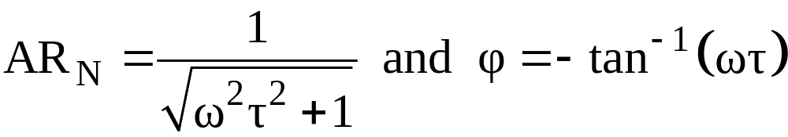
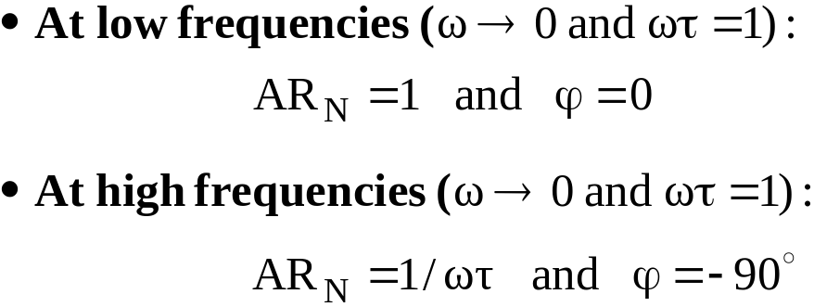
Bode Diagrams
A special graph, called the Bode diagram or Bode plot, provides a convenient display of the frequency response characteristics of a transfer function model. It consists of plots of AR and as a function of ω.
Ordinarily, ω is expressed in units of radians/time.
Bode Plot of A First-order System
Recall:

Slide 10
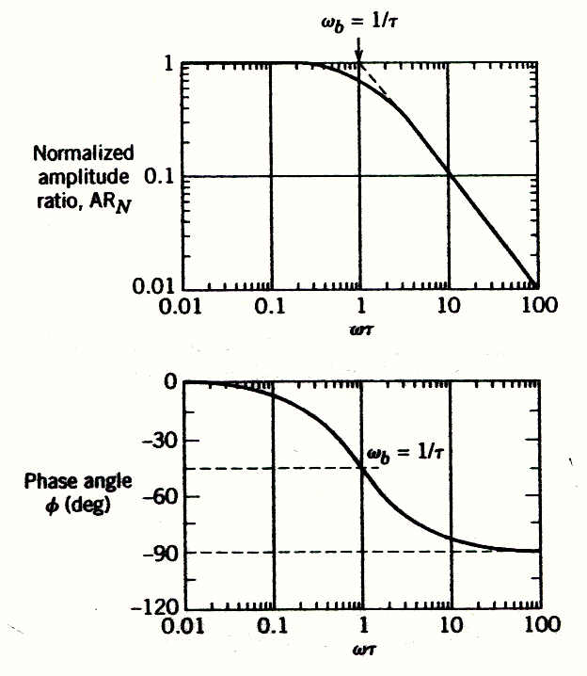
Figure 13.2 Bode diagram for a first-order process.

Slide 11

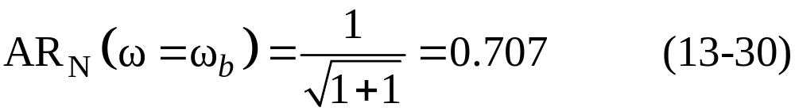
Note that the asymptotes intersect at , known as the break frequency or corner frequency. Here the value of AR_{N} from (13-21) is:
Some books and software defined AR differently, in terms of decibels. The amplitude ratio in decibels AR_{d} is defined as

Slide 12
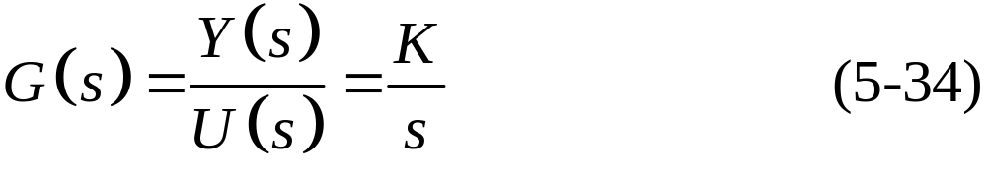
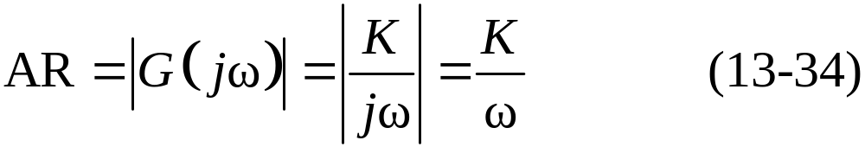
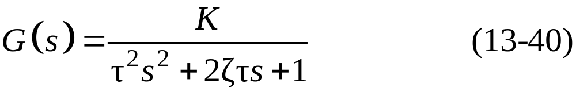
Integrating Elements
The transfer function for an integrating element was given in Chapter 5:
Second-Order Process
A general transfer function that describes any underdamped, critically damped, or overdamped second-order system is

Slide 13
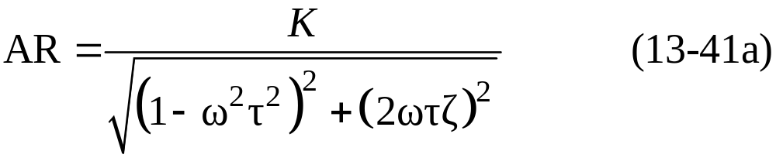
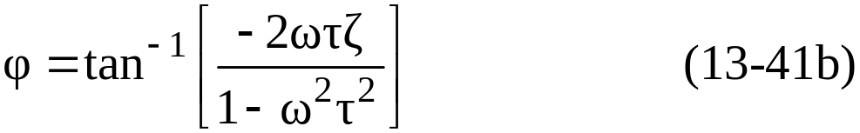
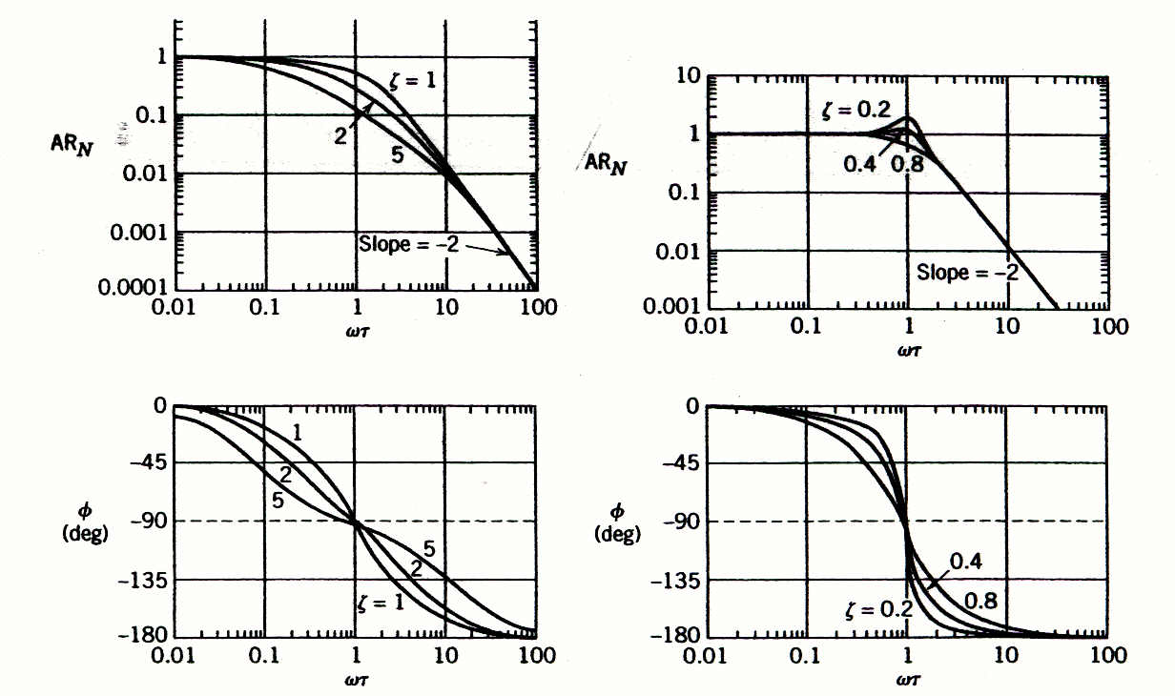
Substituting and rearranging yields:
Figure 13.3 Bode diagrams for second-order processes.

Slide 14
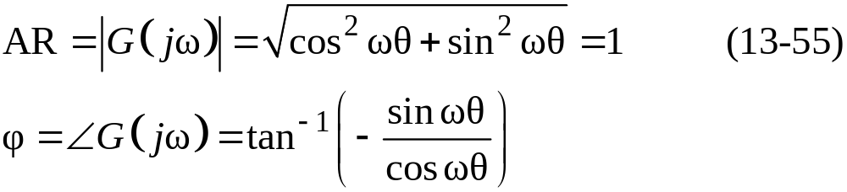
Time Delay
Its frequency response characteristics can be obtained by substituting ,
which can be written in rational form by substitution of the
Euler identity,
From (13-54)
or

Slide 15
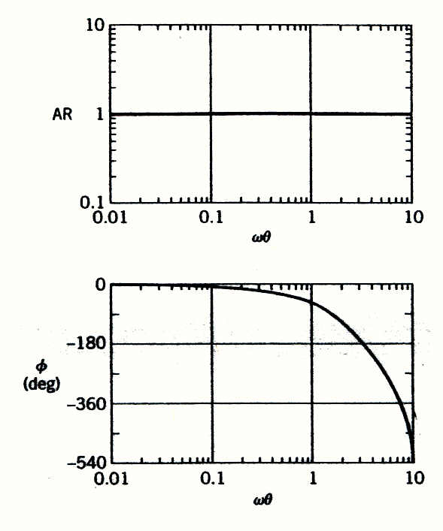

Figure 13.6 Bode diagram for a time delay, .

Slide 16
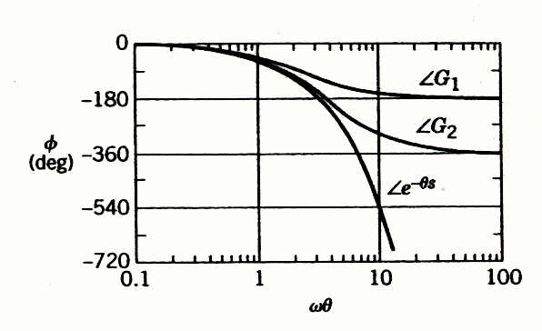
Figure 13.7 Phase angle plots for and for the 1/1 and 2/2 Padé approximations (G₁ is 1/1; G₂ is 2/2).

Slide 17

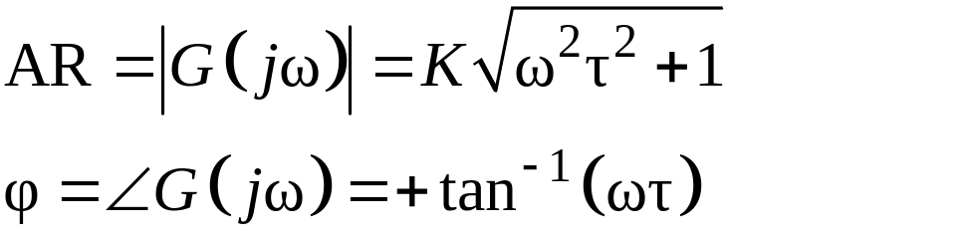

Process Zeros
Consider a process zero term,
Substituting s=jω gives
Thus:
Note: In general, a multiplicative constant (e.g., K) changes the AR by a factor of K without affecting .

Slide 18
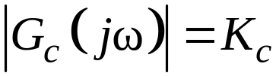
Frequency Response Characteristics of Feedback Controllers
Proportional Controller. Consider a proportional controller with positive gain
In this case , which is independent of ω. Therefore,
and

Slide 19
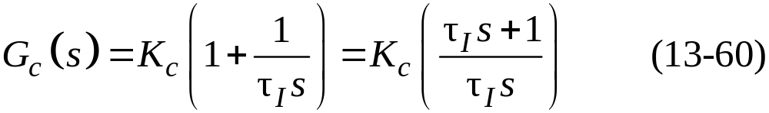
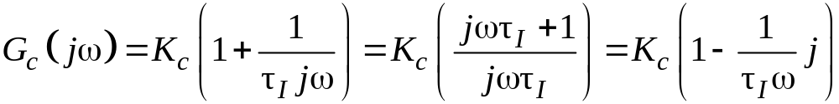
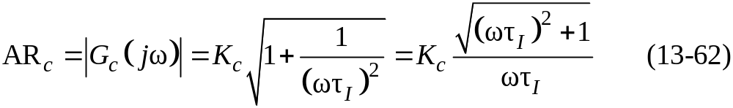
Proportional-Integral Controller. A proportional-integral (PI) controller has the transfer function (cf. Eq. 8-9),
Substitute s=jω:
Thus, the amplitude ratio and phase angle are:

Slide 20
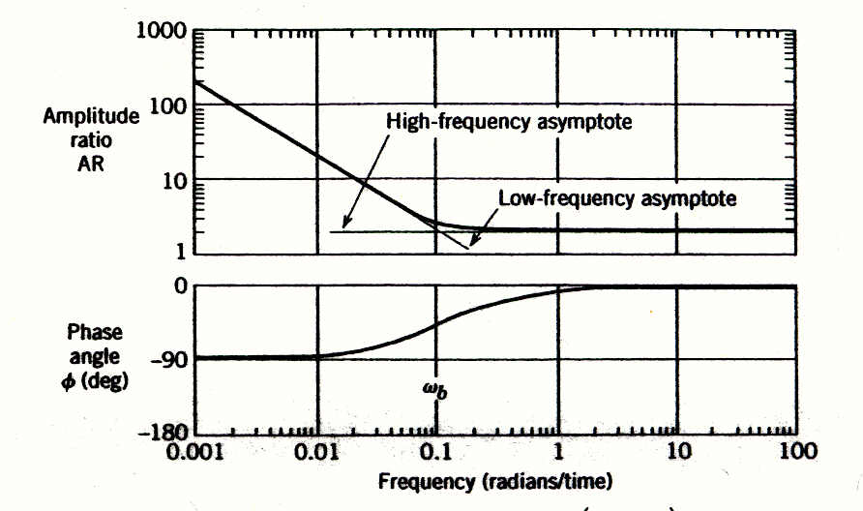
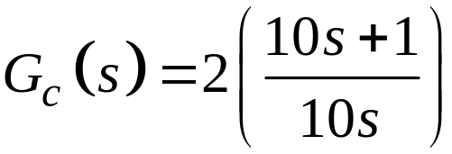
Figure 13.9 Bode plot of a PI controller,

Slide 21
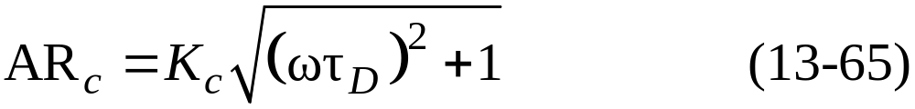
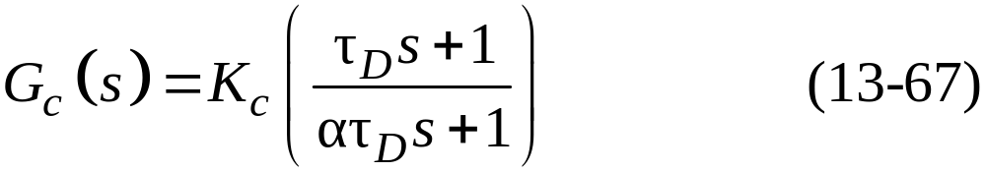
Ideal Proportional-Derivative Controller. For the ideal proportional-derivative (PD) controller (cf. Eq. 8-11)
The frequency response characteristics are similar to those of a LHP zero:
Proportional-Derivative Controller with Filter. The PD controller is most often realized by the transfer function

Slide 22
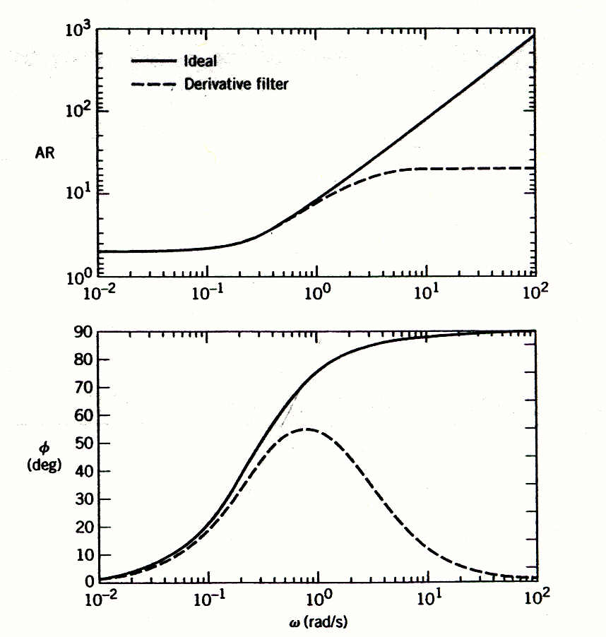

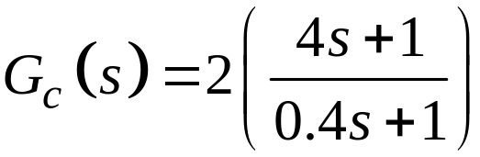
Figure 13.10 Bode plots of an ideal PD controller and a PD controller with derivative filter.
Idea:
With Derivative Filter:

Slide 23
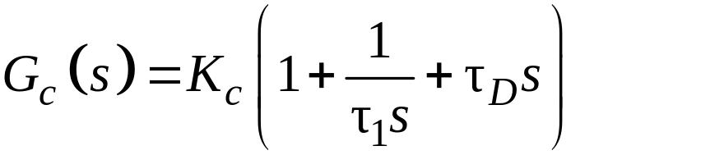
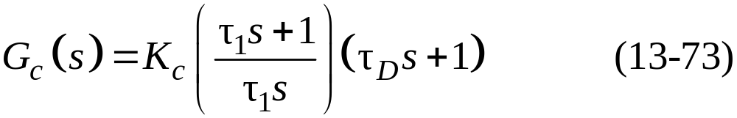
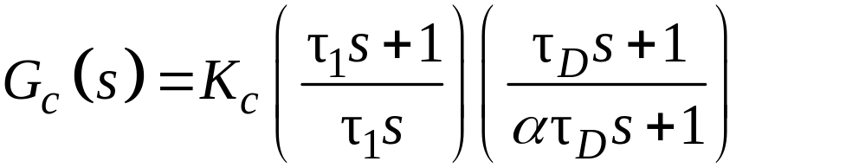
PID Controller Forms
Parallel PID Controller. The simplest form in Ch. 8 is
Series PID Controller. The simplest version of the series PID controller is
Series PID Controller with a Derivative Filter.

Slide 24
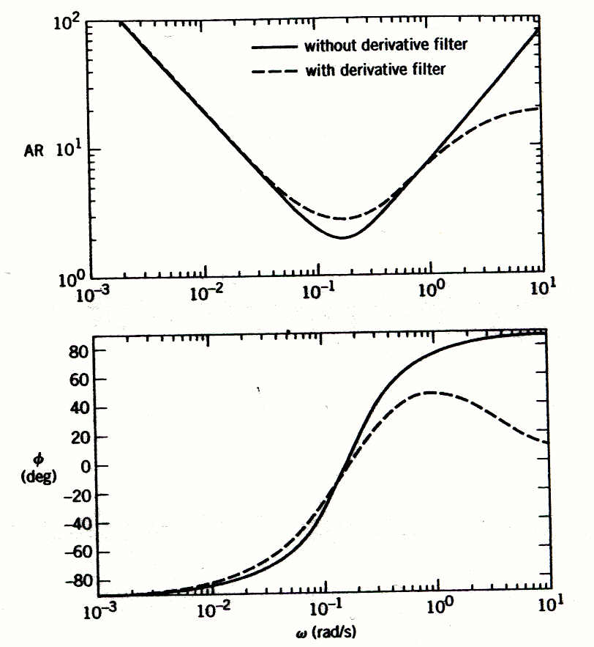
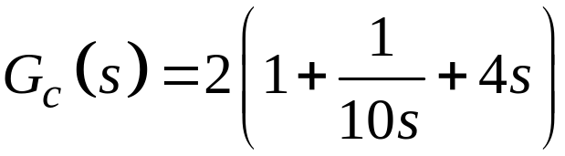

Figure 13.11 Bode plots of ideal parallel PID controller and series PID controller with derivative filter (α = 1).
Idea parallel:
Series with Derivative Filter:

Slide 25


Nyquist Diagrams
Consider the transfer function
with
and

Slide 26



Figure 13.12 The Nyquist diagram for G(s) = 1/(2s + 1) plotting and

Slide 27


Figure 13.13 The Nyquist diagram for the transfer function in Example 13.5:

